Slide 1
High Stakes Math Tests
How NCLB leaves newcomer English
language learners behind
By W.E.Wright & X. Li
Presented by Morgan Pajo and Kaan Ustun

Slide 2
In a nutshell…
Introduction
Challenges for ELLS in Learning Math through English
Research participants & research site
Methodology
School Efforts to assist Nitha & Bora
Struggling with Math in the classroom
Linguistic Complexity
Opportunity to learn Content Analysis
Conclusion & Discussion

Slide 3
Introduction
NCLB: High stakes testing – Including Math
Most ELL Math Test in English
Analysis of 5th Graders Cambodian students in Texas
“Language demands of the test are beyond reasonable for newcomer students” (p. 237)
Implications & needed changes to US Policy

Slide 4
Introduction
Grades 3 8 & High School Math, Reading & Science
ELL < 1 year Exclusion from Reading BUT not Math
NCLB calls for “Reasonable Accomodations”
“Valid & Reliable” But not practicable
Reality is…

Slide 5
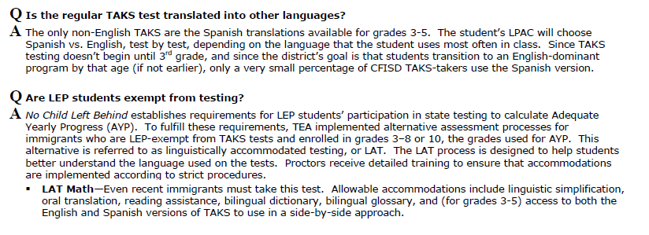
What about students who don’t speak English?
(“Nailing down the TAKS”, 2009)

Slide 6
Challenges
TAKS (Texas Assessment of Knowledge & Skills)
Major misconception: Math poses the least linguistic difficulty for ELL’s
Math = 3rd Language: Voc, Syntax, Semantics & Discourse
Ex: Divisor, Denominator, quotient,…
Ex: Least common multiple
No one-to-one correspondence
Word order Multiple Reading

Slide 7
Other challenges…
“There is a high correlation between English reading ability & performance on math tests given in English” (Brown, 2005) (P.240)
US == Home country
AYP (Adequate Yearly Progress)
ELL’s Subgroup within NCLB
Expectations: Harmful & Unreasonable

Slide 8
Context of Research: Who, Where & What
Country: Cambodia
Location: Middle School in Texas
Participants: 2 Cambodian Sisters
English Level: 1 year : Communicate at Basic Level
School: 590 students
58 % White
29 % Hispanic
10 % African American
2 % Asian & Pacific Islander

Slide 10
Methodology & Assistance
Participant Observation; Interviews; Analysis of school documents; Analysis student work.
Lexical Analysis of 5th Grade Math TAKS Test with Web Vocabulary Profiler
American & Cambodian Textbooks
Differentiated instruction
Pull out English (ESL)
L1 support & Weekly Tutoring
Results: Bora: 6/44 & Nitha: 7/44

Slide 11
Struggles
“An analysis of the content of the students math school work in comparison with the TAKS test revealed their school work was far below the level of TAKS test. In addition, the TAKS assessed many concepts not covered in the girls school work” (Wright & Li, 2008, p.243)
Multiple steps VS Single Steps

Slide 12
Linguistic Complexity
Math has “a language all its own”, constituting as a “third language” (Brown, 2005)
Unique vocabulary, syntax, semantic properties, and discourse
Quotient, table, column, in total, altogether, etc.
Word problems contain complex syntax and difficult lexical terms
Different countries have different mathematical systems
4,232.56 (USA) = 4.232,56 (Cambodia)

Slide 13
One Math Problem
“ A farmer brought watermelons to the market. He sold 15 melons for $54.75. It cost him $1.12 to grow and harvest each melon. How much profit did he make on the sale of one melon?”
( 54.75 / 15 ) – 1.12
What kind of knowledge is needed to solve word problems like this?

Slide 14
Just a few features…
Math-specific terms
Operative clue words
Extra information
Word-to-number translation
Special math meanings for common words
Infinitive
Attributive clause
Passive voice
Comparative
Conditional clause
Past participial phrase
Adverbial clause
Multiple clauses
Objective clause
Gerund
Negation in Q
Superlative

Slide 15
Lexical Analysis
“ A farmer brought watermelons to the market. He sold 15 melons for $54.75. It cost him $1.12 to grow and harvest each melon. How much profit did he make on the sale of one melon?”
farmer
brought
watermelon = melon
market
grow and harvest
sold
cost
profit
sale

Slide 16
Linguistic Complexity - Lexical Features
Math-specific academic words
“A rectangular prism made of 1-centimeter cubes is shown below. What is the volume of this rectangular prism?”
Absence of familiar clues for operations
In our school there are 328 girls and 297 boys. How many children are there in our school all together?
Converting words into numbers
[“Roses—$1.00 each or $10.00 per dozen’’].
Differences in meanings
Which pair of eagle pictures shows a translation?’’

Slide 17
Linguistic Complexity – Syntactic Features
Use of infinitive
To determine whether they are halfway to their goal of $450.00, what should the students do?
Use of superlatives
If the shelf is 3 feet long, what is the greatest number of videotapes that Stella can store on the shelf?
Negation in questions
Which of the following combinations of supplies does she NOT have enough money to buy?
Conditional clause + gerund + attributive clause
If she picks a card without looking, what is the probability that it will have the letter S on it?

Slide 18
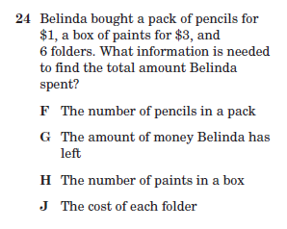
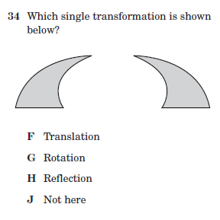
Math: Not just numbers…

Slide 19
Conclusion
CITATION NEEDED

Slide 20
Discussion Questions
How important is it for the teachers to understand the cultural background of their students in order to help them with NCLB testing?
What types of support would you as a teacher offer nonnative English speakers in order to pass the NCLB testing?
Where do the teacher’s assistance and responsibility begin and end with NCLB testing?
How should NCLB tackle the multiple language background issue?

Slide 21
References
Brown, C. L. (2005). Equity of literacy-based math performance assessments for English language learners. Bilingual Research Journal, 29(2), 337–364.
Wright, W.E. & Li, X. (2008). High-stakes math tests: How No Child Left
Behind leaves newcomer English language learners behind. Language
Policy, 7, 237-266. doi: 10.1007/s10993-008-9099-2
Department of Curriculum & Instruction (2009). Nailing down the TAKS.
Cypress-Fairbanks Independent School District.
TAKS Released Tests, Answer Keys, and Scoring Guides:
http://www.tea.state.tx.us/student.assessment/released-tests/

